Slide 1

A Decision Support System for Effective Police Patrolling
August 2019
Varsha Waingankar

Slide 2
Table of Contents
Planning Phase
Problem Statement
Context
Roadmap
Preparation Phase
Data
Crime Categories
Twitter Streaming API
Grid creation
Hot Maps for Crimes
Modeling Phase
Sentiment Analysis
Kernel Density Estimation
Topic Modeling – Latent Dirichlet Allocation
LDA Visualizations
Model Execution and performance Evaluation
ROC Curve
Conclusion
Conclusion

Slide 3
Problem Statement
Effective use of police or patrol cars can be critical for overstretched municipalities across the country.
The goal is to help decision makers to more efficiently allocate police patrols and officer time, which are very expensive and scarce for many jurisdictions
Planning Phase Preparation Phase Modeling Phase Conclusion

Slide 4
Context
Report found that from 1997 to 2016 in the United States, the rate of full-time sworn officers per 1,o00 residents decreased by 11 percent.
During the same period, the general population in the U.S. increased by 21 percent.
The population of Chicago is close to 2.9 million and total number of police officers is 12k
In Chicago for every 10k population, there are just 44 officers
Reference
https://www.sciencedirect.com/science/article/pii/S0167923614000268
Planning Phase Preparation Phase Modeling Phase Conclusion

Slide 5
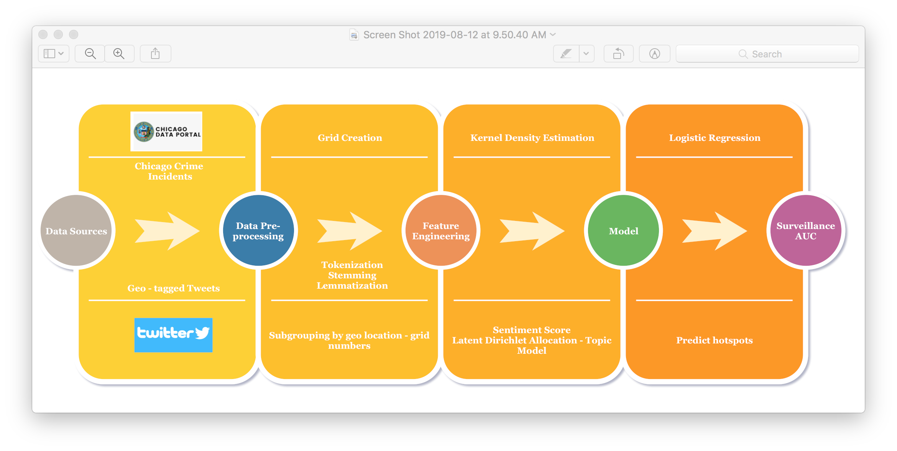
Roadmap
Planning Phase Preparation Phase Modeling Phase Conclusion

Slide 6
Data
Crime Data
Using the Chicago Crime Data Portal, information was collected on all crimes documented between June 22, 2019 and August 1, 2019.
Each crime record in our subset contained a timestamp of occurrence, latitude/longitude coordinates of the crime at the city- block level, and one of 25 types (e.g., ASSAULT and THEFT).
Twitter Data
During the same time period, tweets tagged with GPS coordinates falling within the city limits of Chicago, Illinois were also collected
This was done by using the official Twitter Streaming API, defining a collection bounding box with coordinates [− 87.94011,41.64454] (lower-left corner) and [− 87.52413,42.02303] (upper-right corner).
Planning Phase Preparation Phase Modeling Phase Conclusion

Slide 7
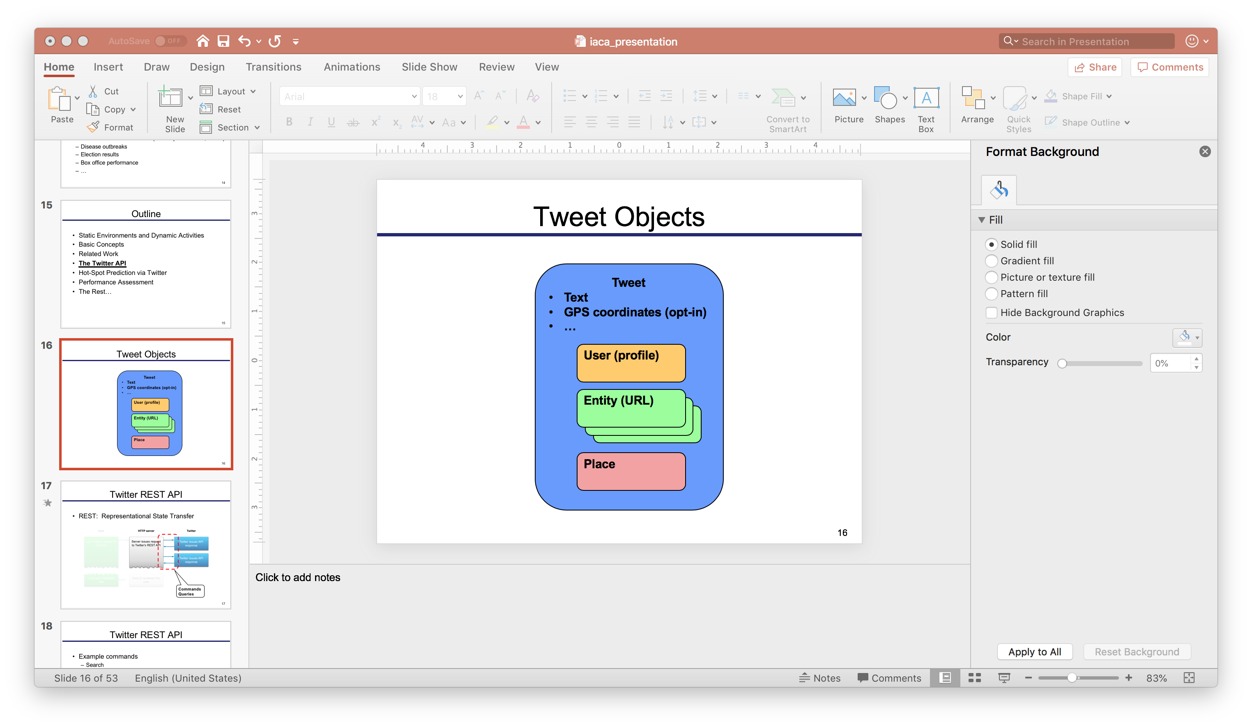
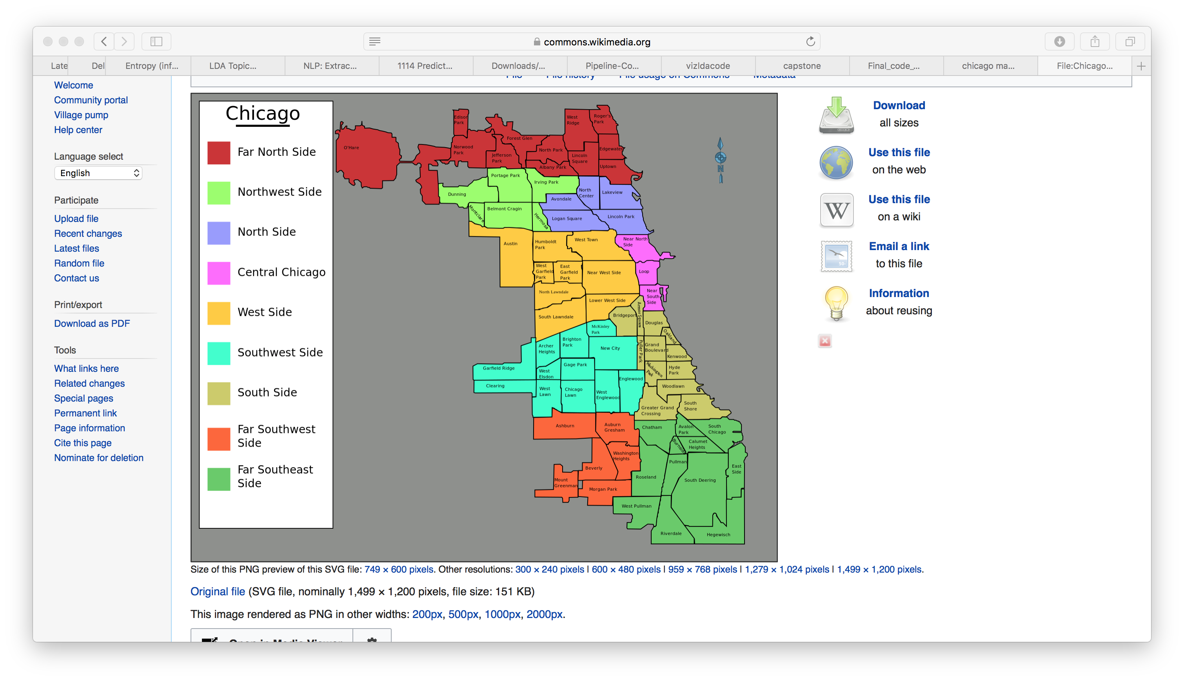

Twitter Streaming API
Example stream: Filter
Long: -87.5241371038858
Lat: 42.0230385869894
Dropbox
Long: -87.9401140825184
Lat: 41.6445431225492
Planning Phase Preparation Phase Modeling Phase Conclusion

Slide 8
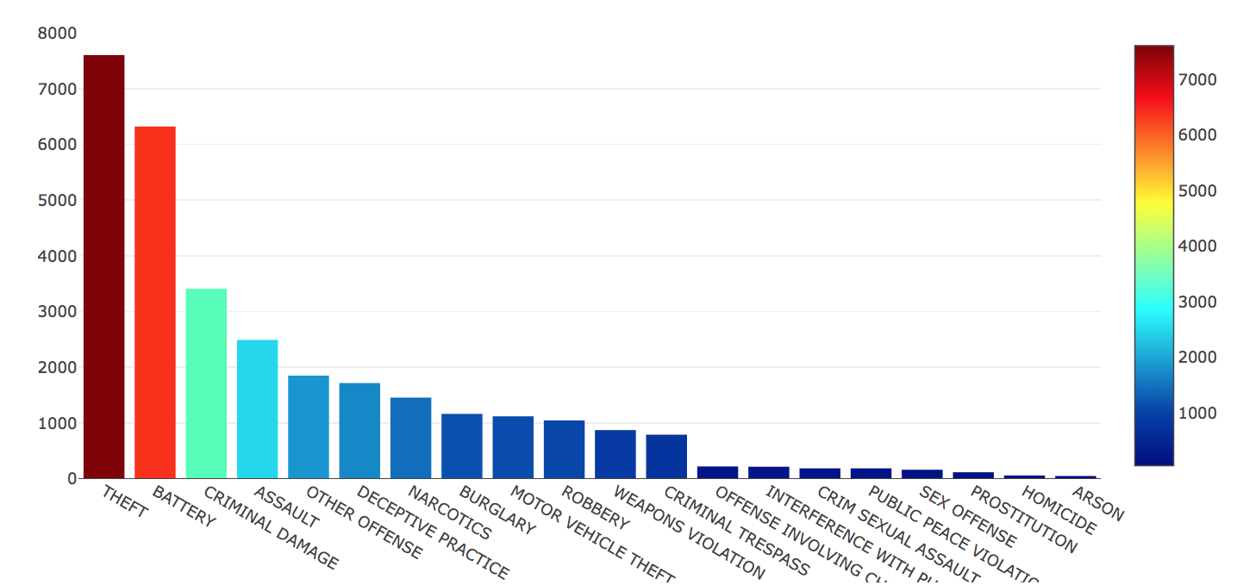
Crime Categories
Planning Phase Preparation Phase Modeling Phase Conclusion

Slide 9
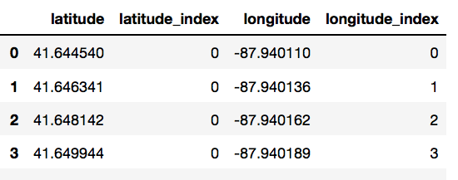
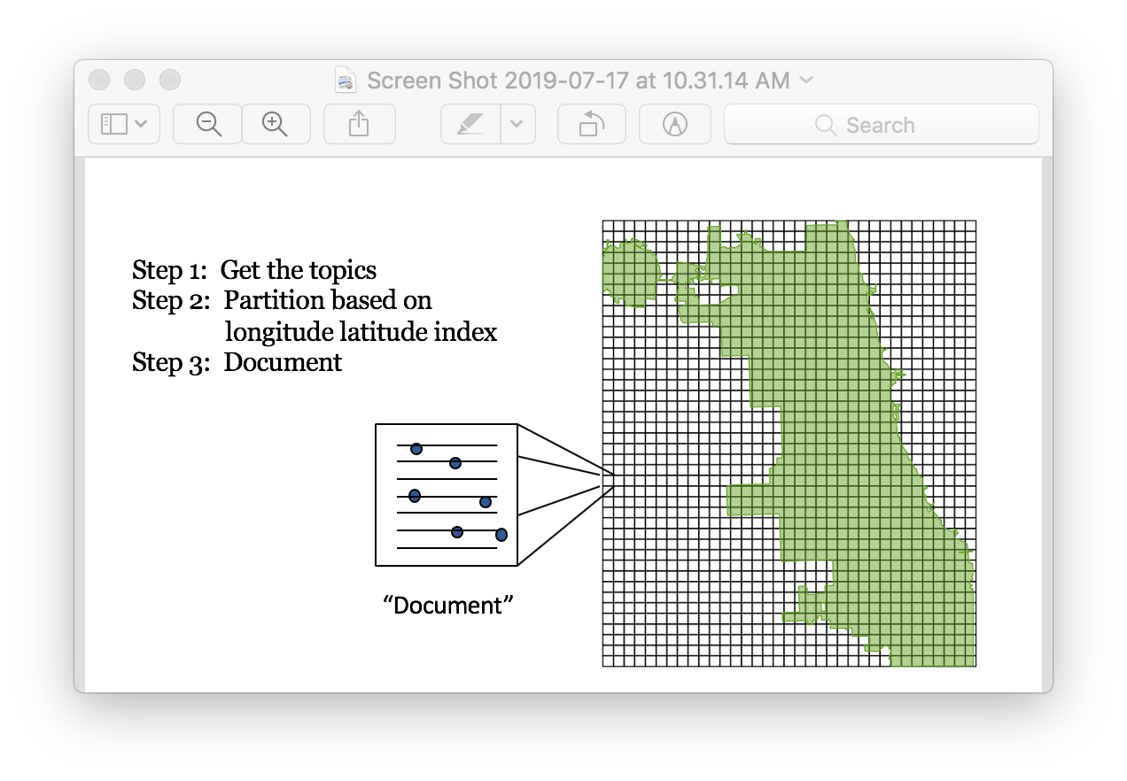
Grid Creation
From the locations of known crimes of type T within the training window (these points received a label True)
From a grid of evenly spaced points at 200- meter intervals, not coinciding with points from the first set (these points received a label False).
Grid of Locality
City grid divided into 200 meter squares
Long: -87.9401140825184
Lat: 41.6445431225492
'latitude', 'longitude’, 'latitude index’, 'longitude index', 'crime'
Data Crime Type Theft
Long: -87.9401140825184
Lat: 41.6445431225492
Planning Phase Preparation Phase Modeling Phase Conclusion
Notes:
The Universal Transverse Mercator (UTM) is a system for assigning coordinates to locations on the surface of the Earth. Like the traditional method of latitude and longitude, it is a horizontal position representation, which means it ignores altitude and treats the earth as a perfect ellipsoid

Slide 10
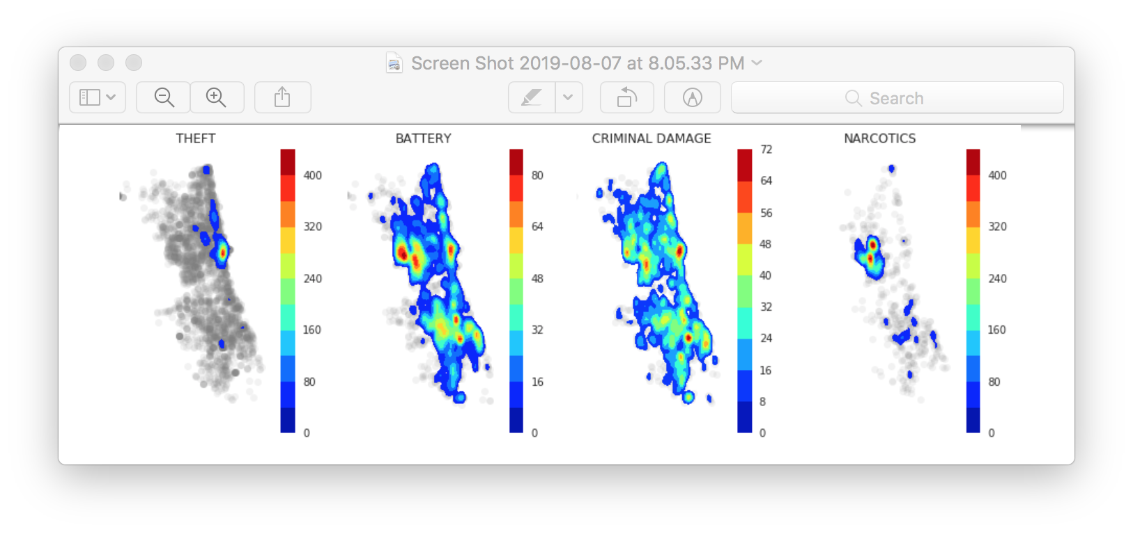
Kernel Density Estimation
Kernel Density Estimation (KDE) is a non-parametric technique for density estimation.
A known density function (the kernel) is averaged across the observed data points to create a smooth approximation.
Estimation data: historical crime record
Threat
Planning Phase Preparation Phase Modeling Phase Conclusion

Slide 11
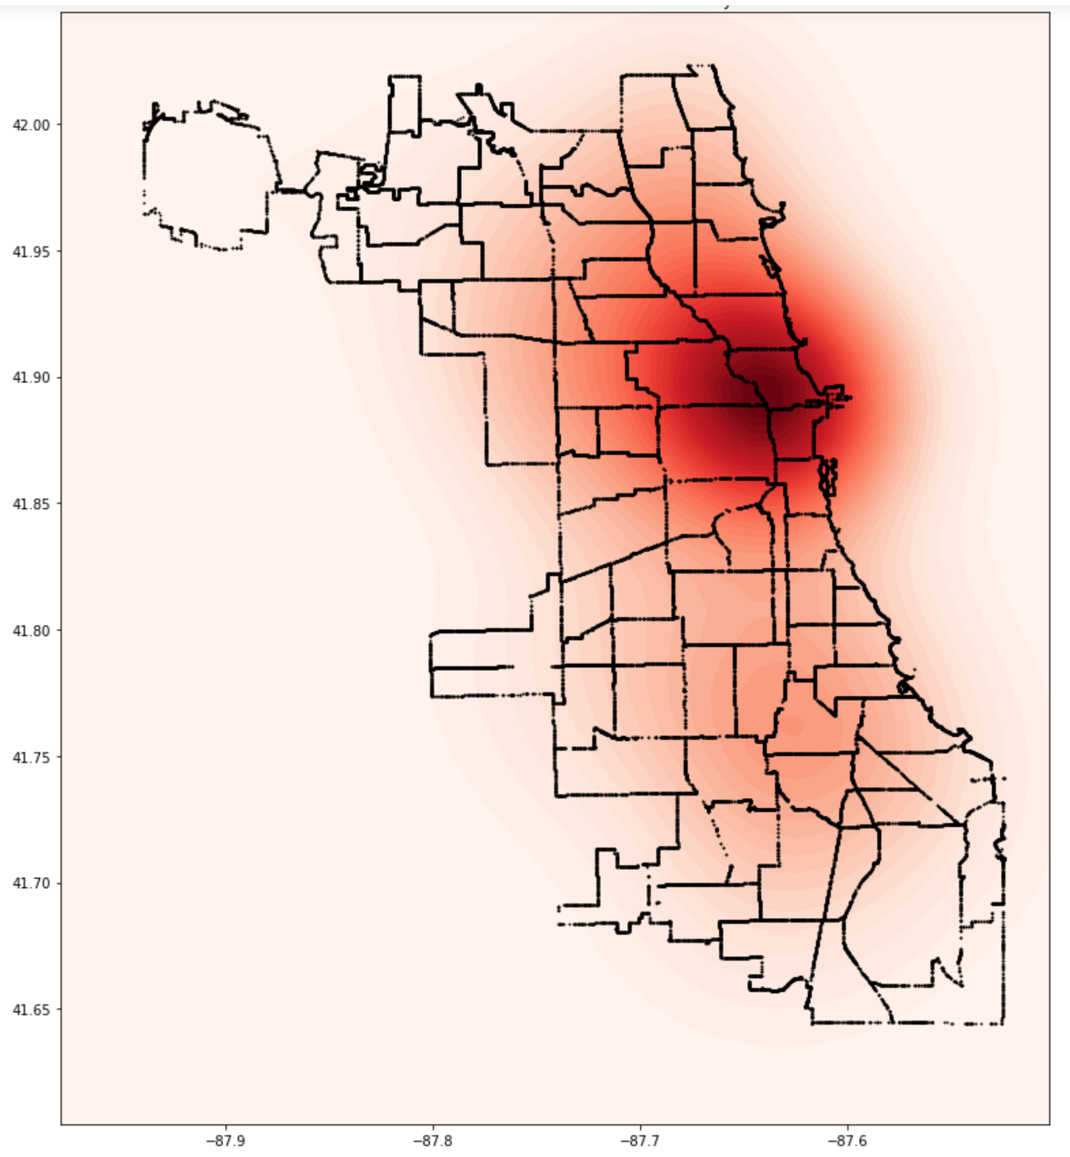
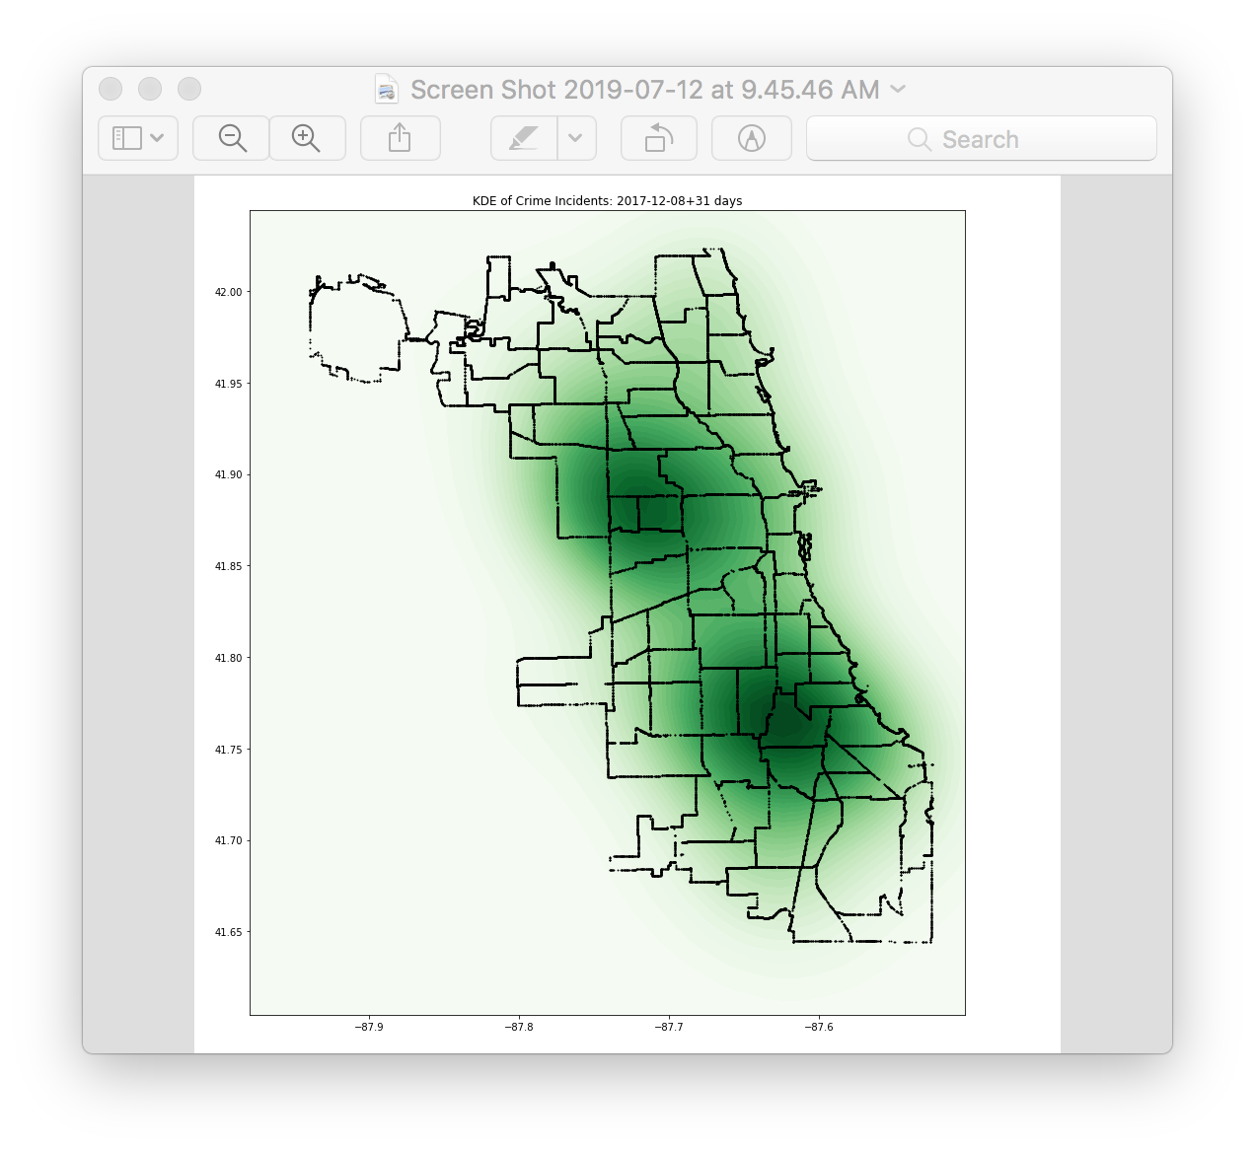
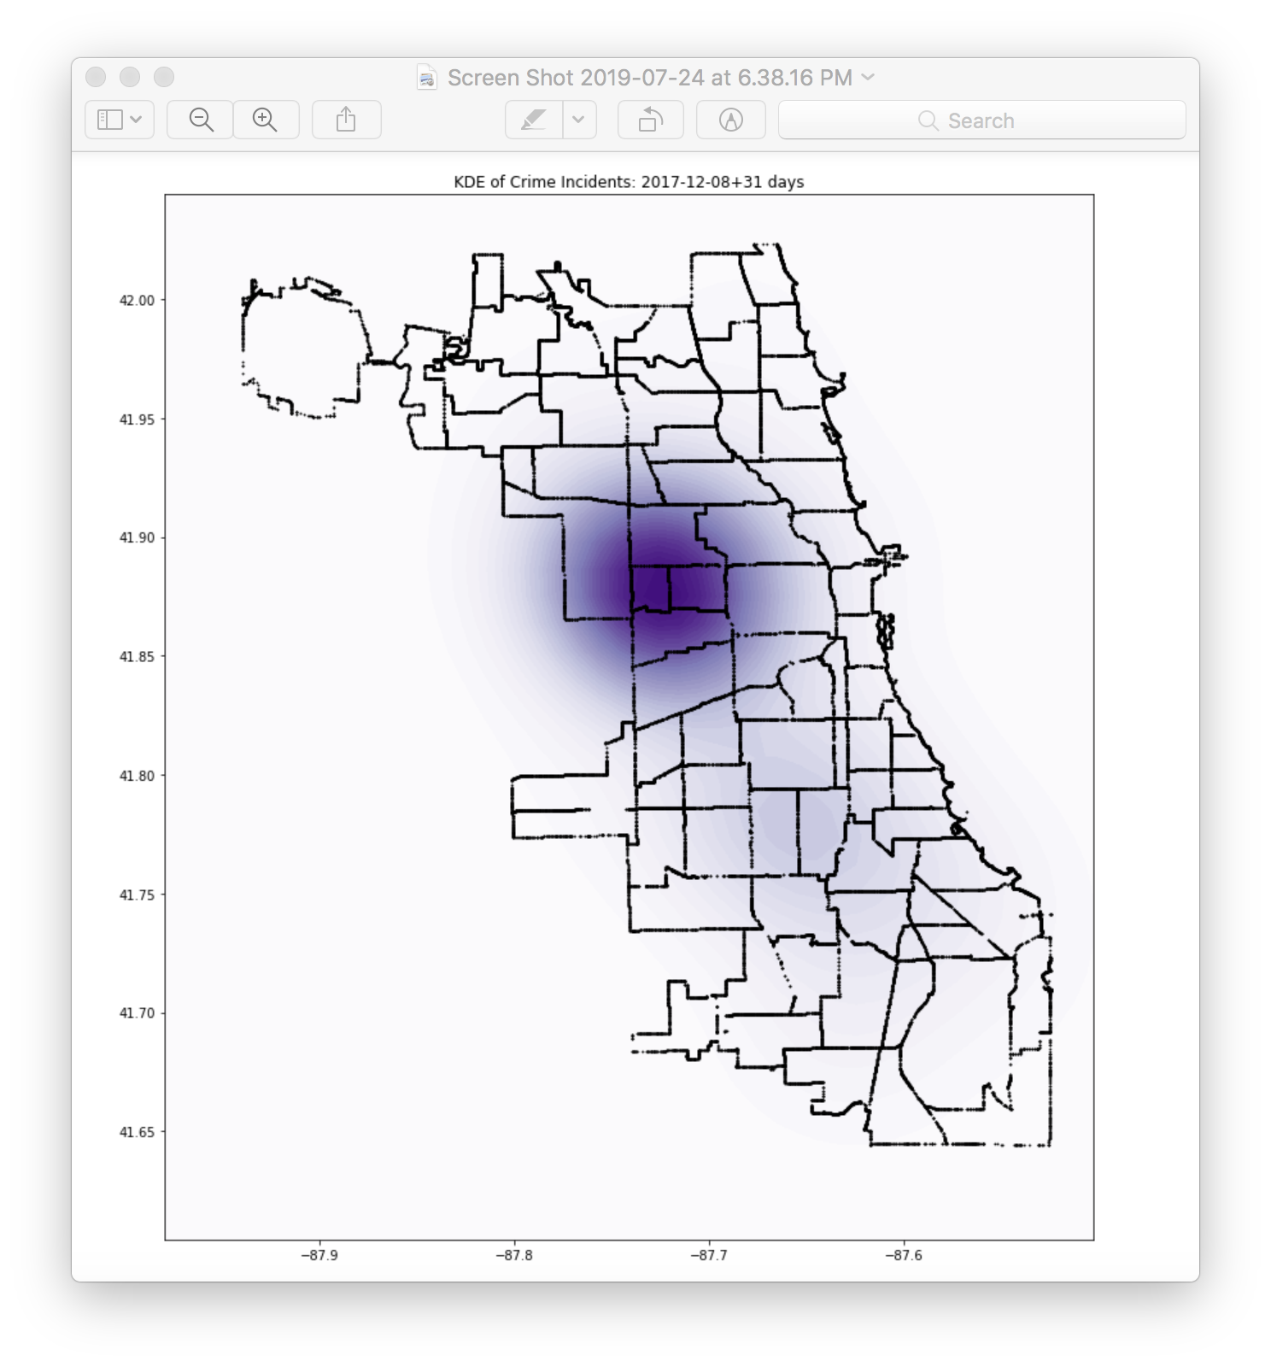
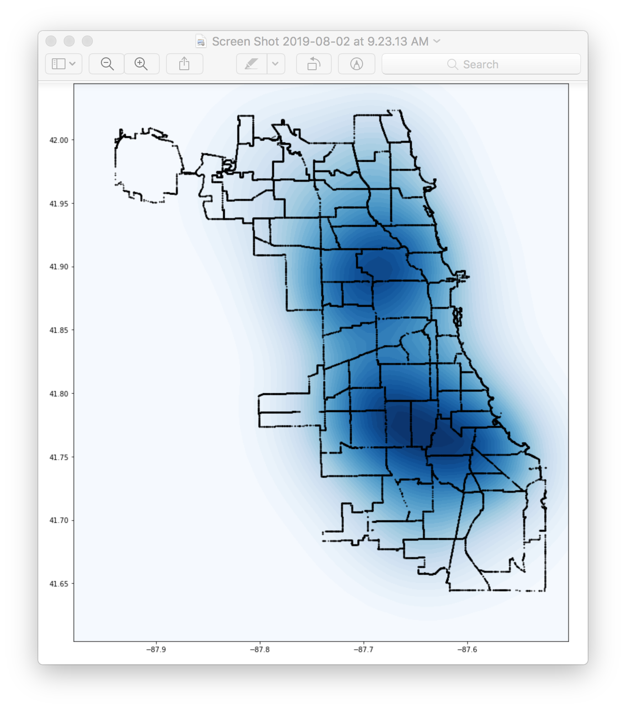
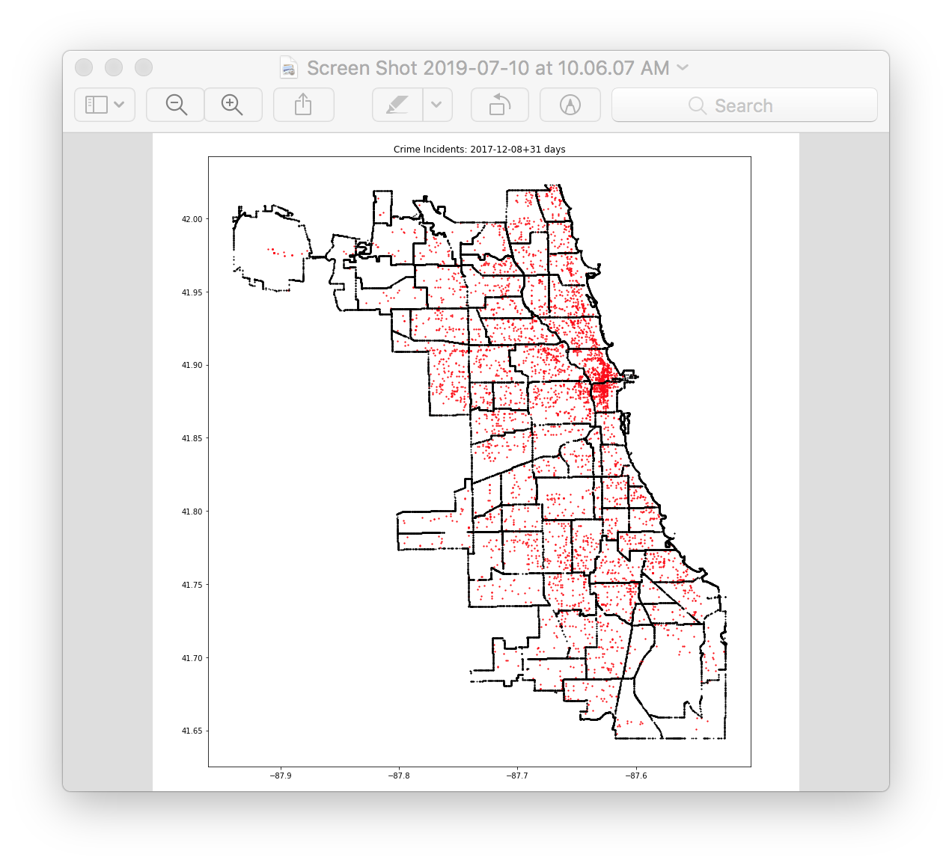
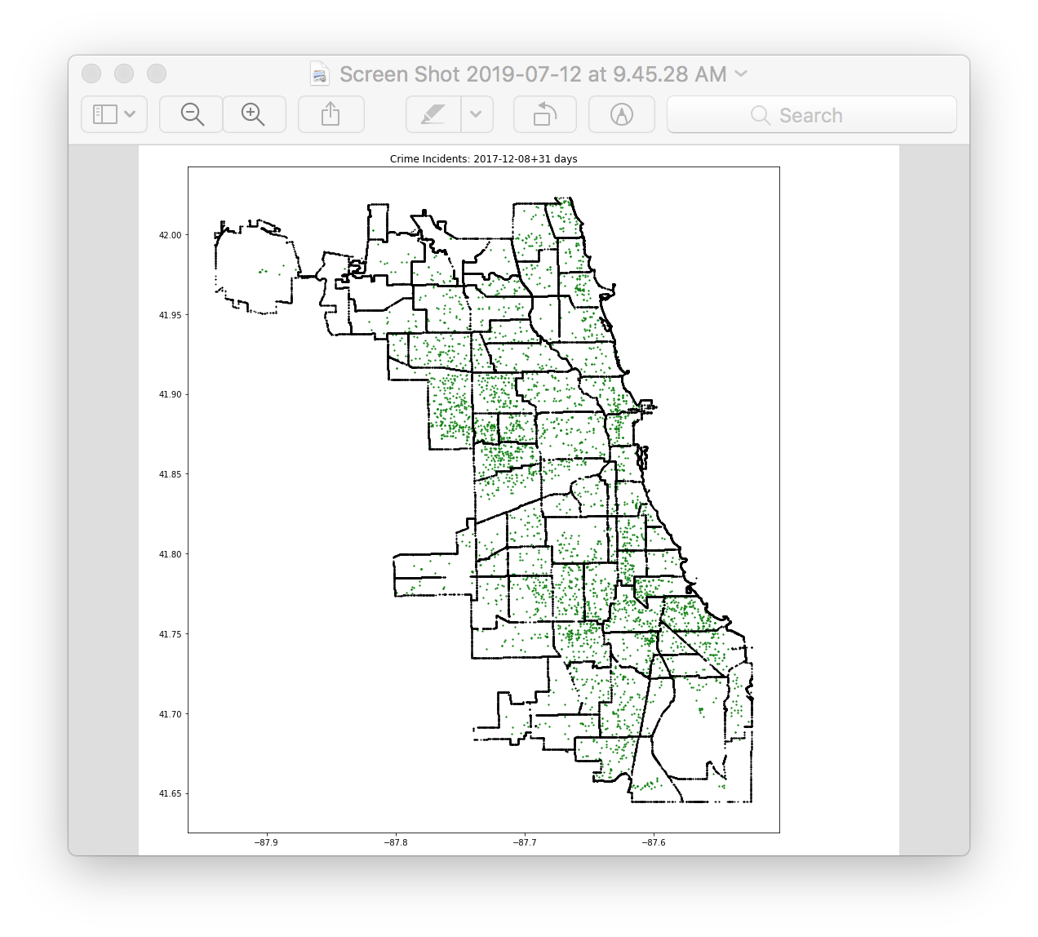
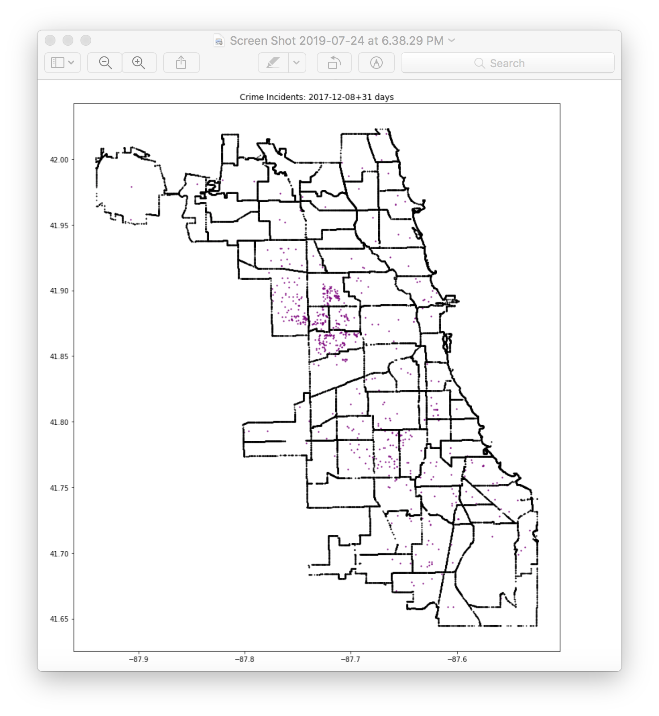
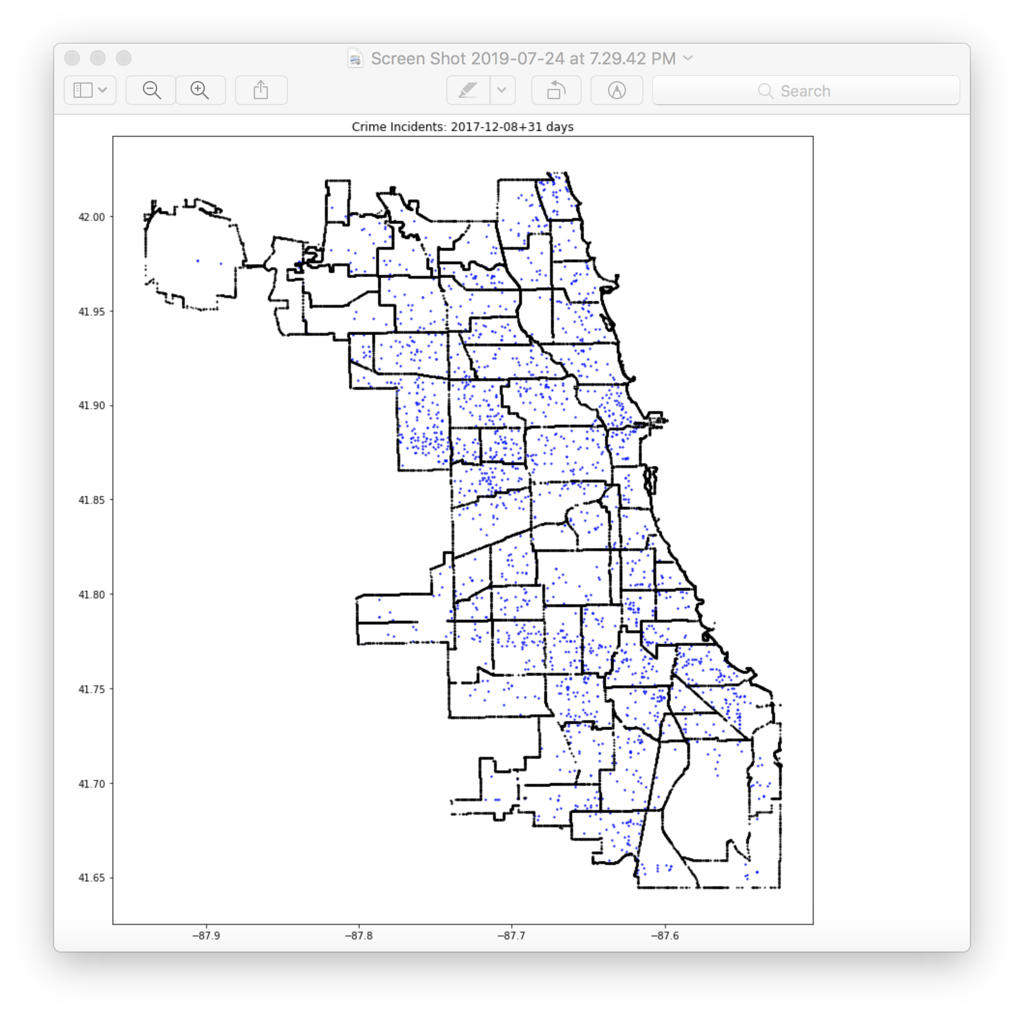
Hot map for crime types using KDE
Theft Battery Narcotics Burglary
Planning Phase Preparation Phase Modeling Phase Conclusion

Slide 12
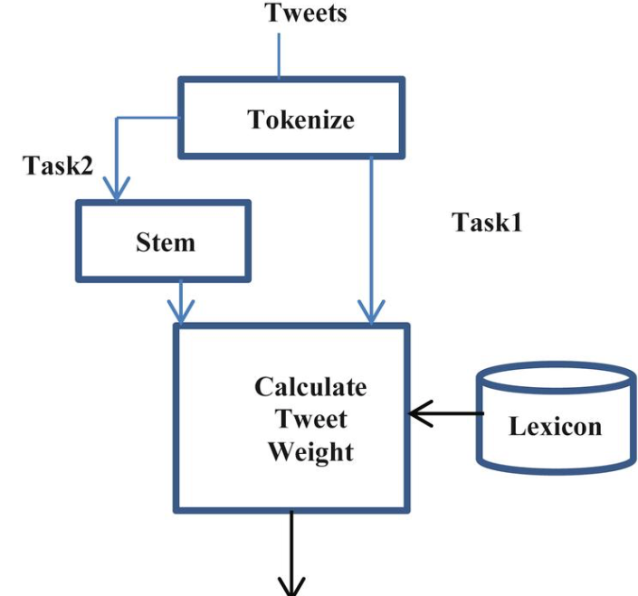
Sentiment Analysis on Tweets
There are two major approaches:
Supervised machine learning approaches
Unsupervised lexicon-based approaches
Unsupervised method for predicting the sentiment by using lexicons that have detailed information, specially curated and prepared just for sentiment analysis was used.
AFINN lexicon for sentiment extraction and analysis was implemented
Planning Phase Preparation Phase Modeling Phase Conclusion
Notes:
For supervised learning we typically need pre-labeled data.
The AFINN lexicon is a list of English terms manually rated for valence with an integer between -5 (negative) and +5 (positive) by Finn Årup Nielsen between 2009 and 2011. The original lexicon contains some multi-word phrases, but they are excluded here.

Slide 13
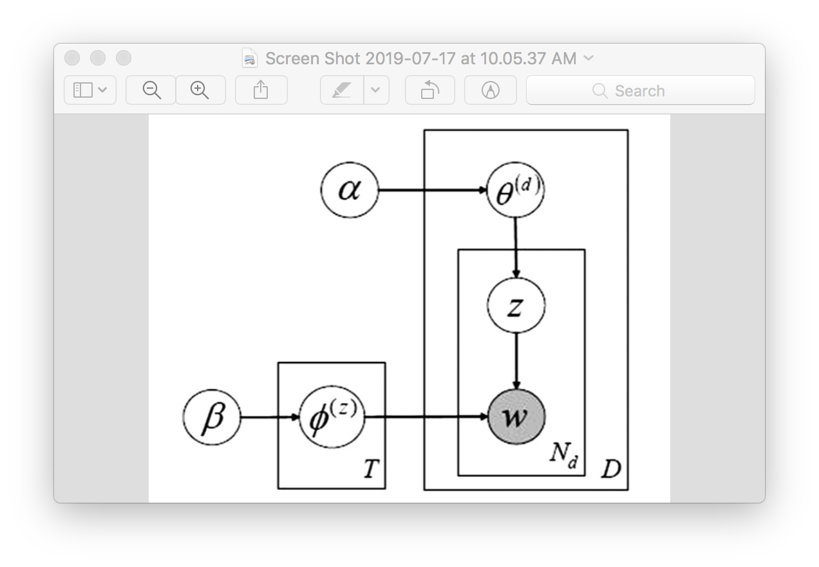
Topic Modeling – Latent Dirichlet Allocation
Preprocess text, apply tokenization, stemming, lemmatization
Remove the stop words
Apply topic models
. Neighborhood boundaries for computing tweet-based topics. Used only the green neighborhoods (i.e., those within the city boundary) for analysis.
Planning Phase Preparation Phase Modeling Phase Conclusion
Notes:
This also uses 200 meter threat squares, but any two points residing in the same 1000 meter by 1000 meter topic neighborhood will have identical feature based values.
Tf idf used and concentrated on counts
Lda co occurrence of words

Slide 14
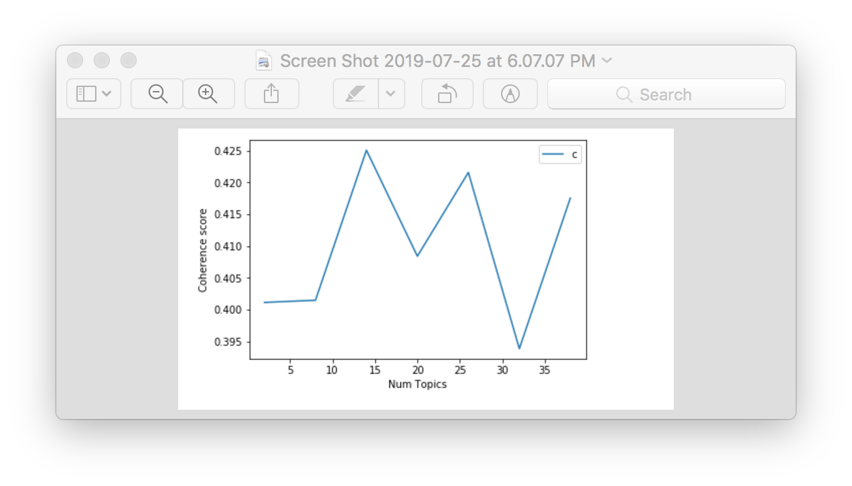
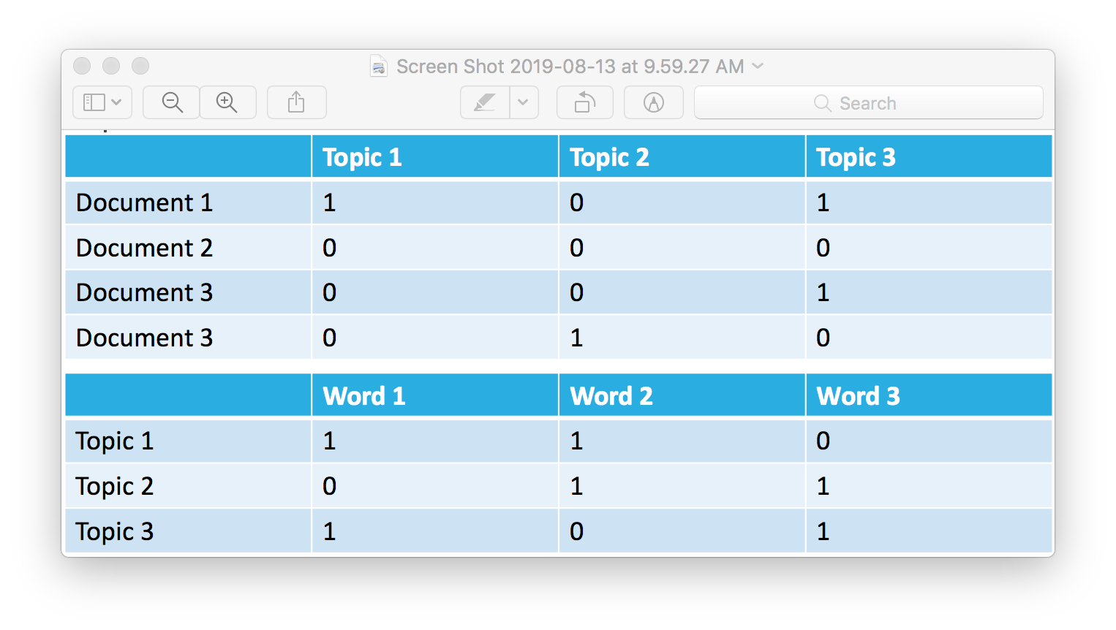
Coherence Score
This score is trying to quantify the semantic similarities of the high scoring words within each topic.
A high score means the result is more human-interpretable that indicates a better model.
Document collections start as matrices of terms and documents
Planning Phase Preparation Phase Modeling Phase Conclusion

Slide 15
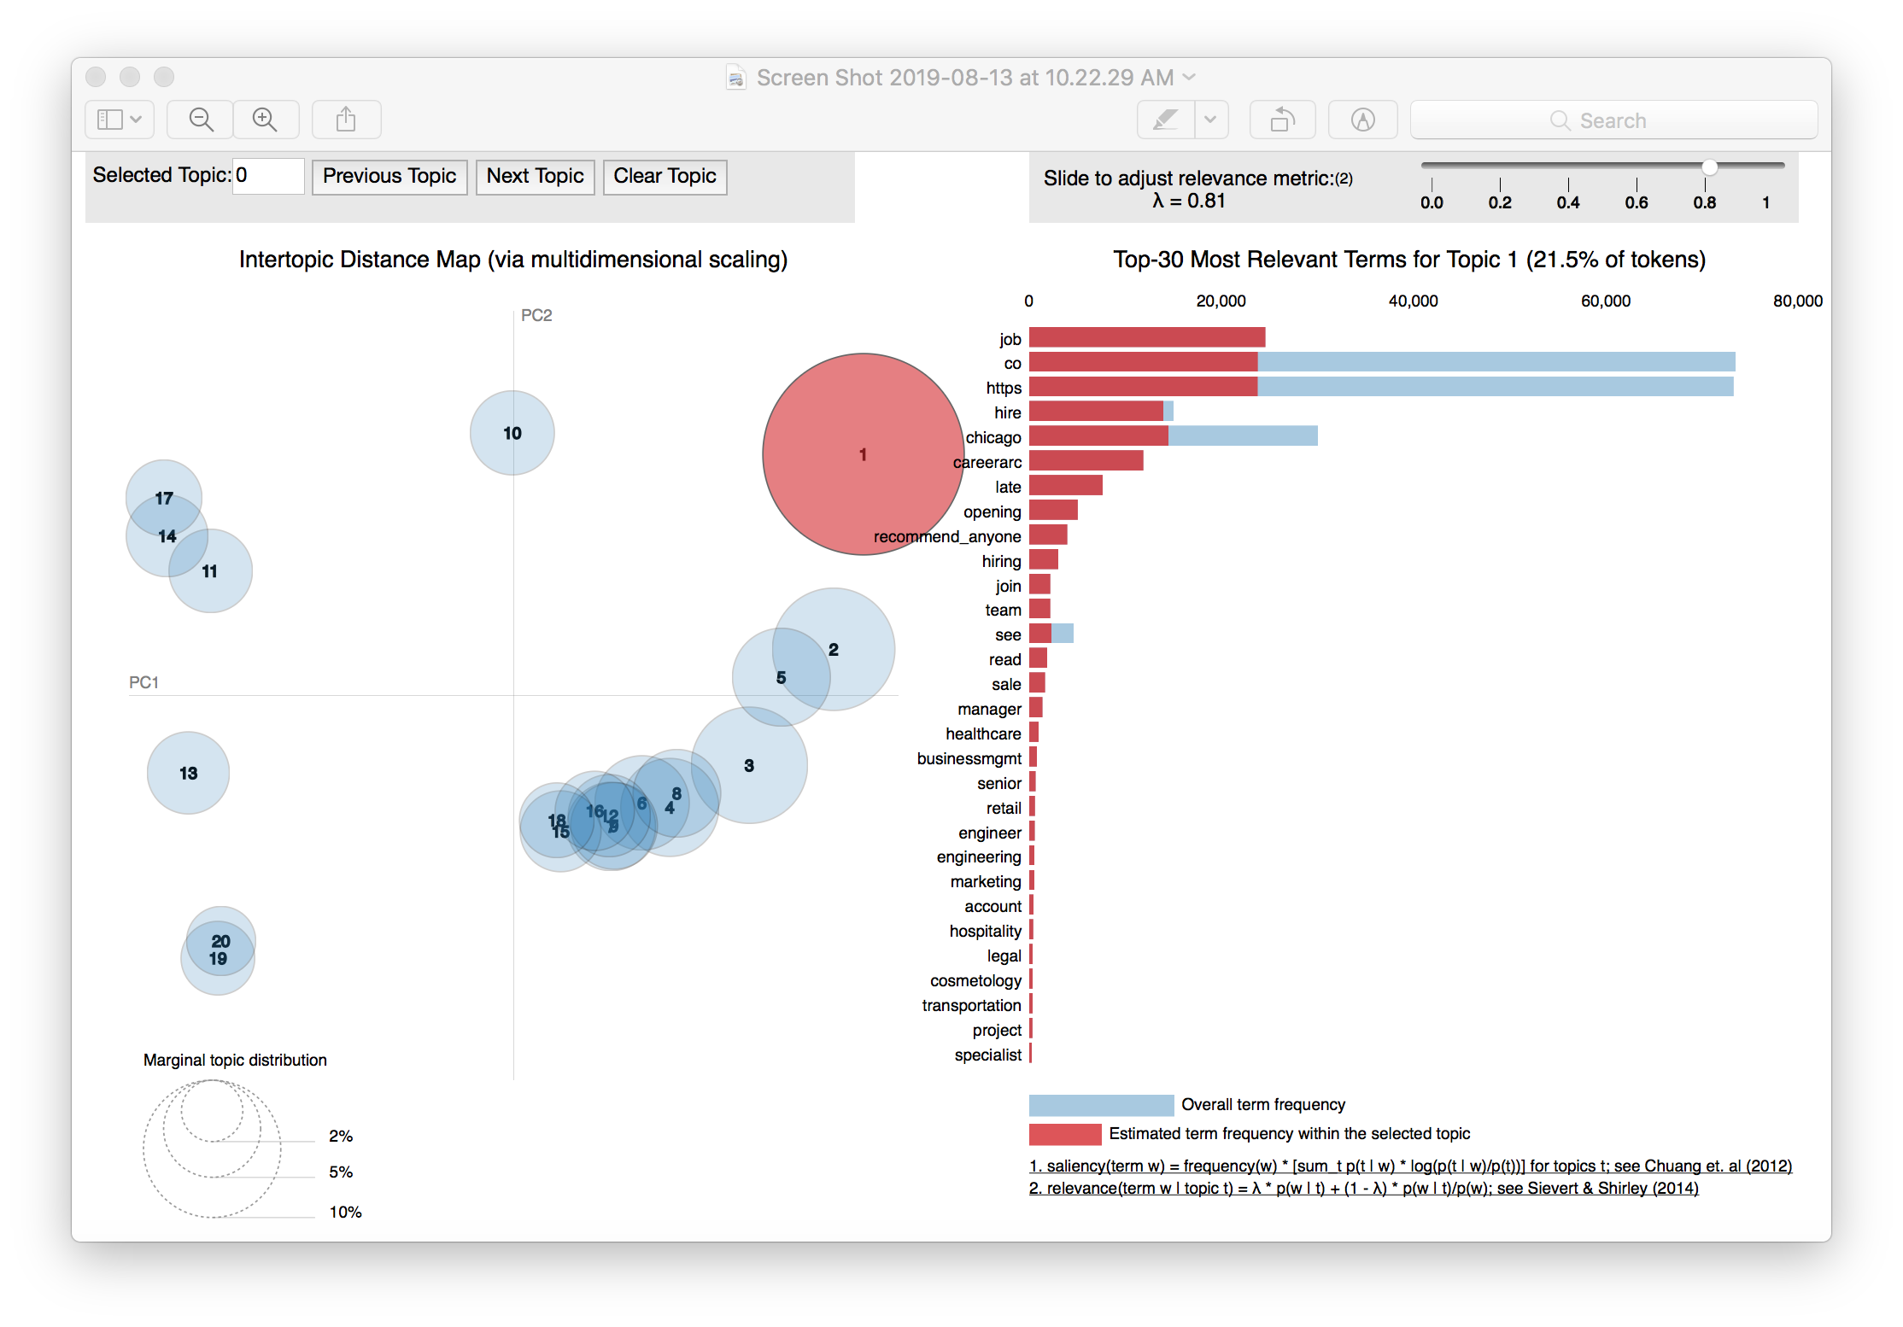
LDA Visualization
Planning Phase Preparation Phase Modeling Phase Conclusion

Slide 16
Model Execution and Performance Evaluation
Model
Training the model on 31 day window for crime type T.
Making T predictions for the first day following the training window, sliding one day into the future and repeating.
Evaluation
Project the surveillance plot that measures the percentage of true T crimes during prediction window , that occur within the most threatened area, according to models prediction for T
Lastly, because each model execution produced a series of surveillance plots for crime type T, one for each prediction day, aggregate the plots to measure overall performance
Planning Phase Preparation Phase Modeling Phase Conclusion
Notes:
Threatened areas – using logistic regression , probabilities of grid cells, that had true label
Just fetch the grid cells , where the logistic regression predicted the label to be true
Evaluate the performance of each days prediction using surveillance plot – A surveillance plot measures the percentage of true T crimes during prediction window , that occur within the x% most threatened area, according to models prediction for T
Model execution will produce a series of plots for crime type T, one for each day prediction, aggregate the plots to measure overall performance

Slide 17
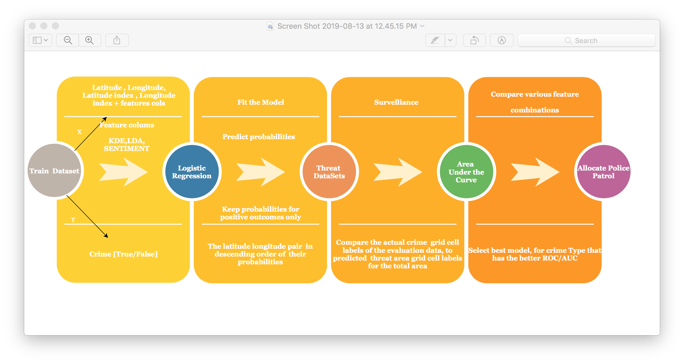
Model Execution
Planning Phase Preparation Phase Modeling Phase Conclusion

Slide 18
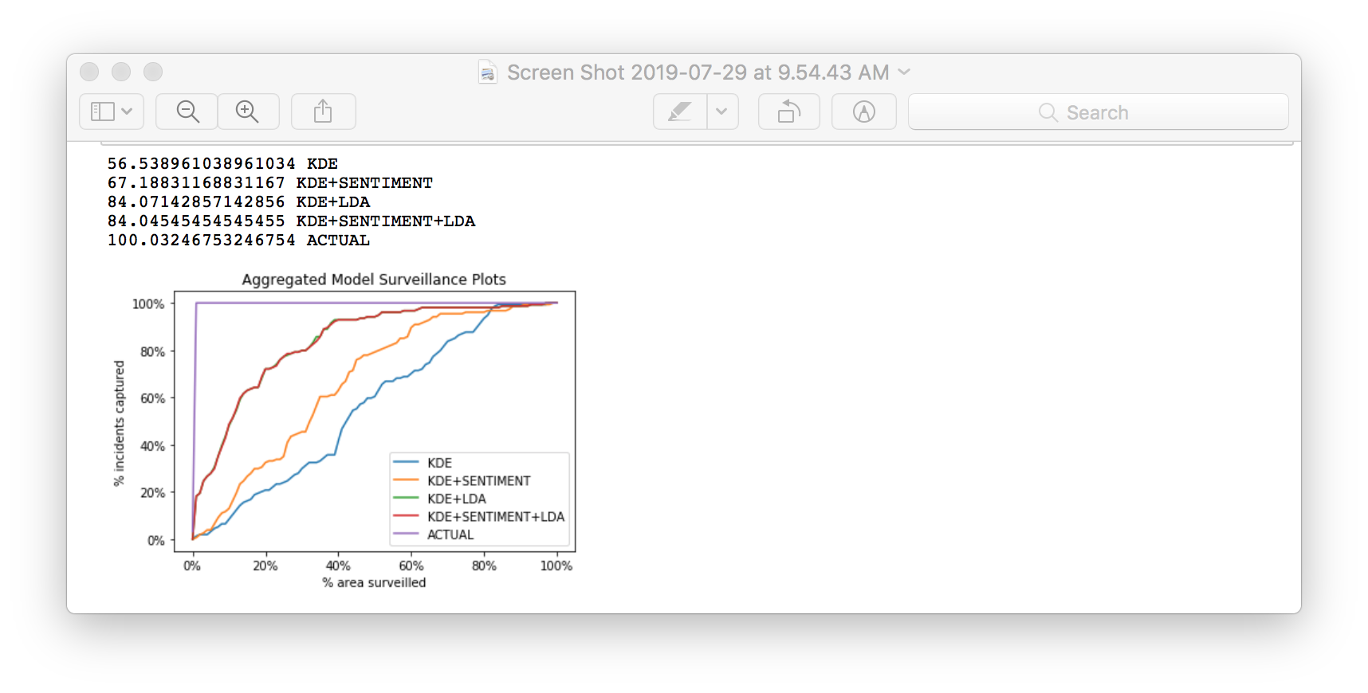
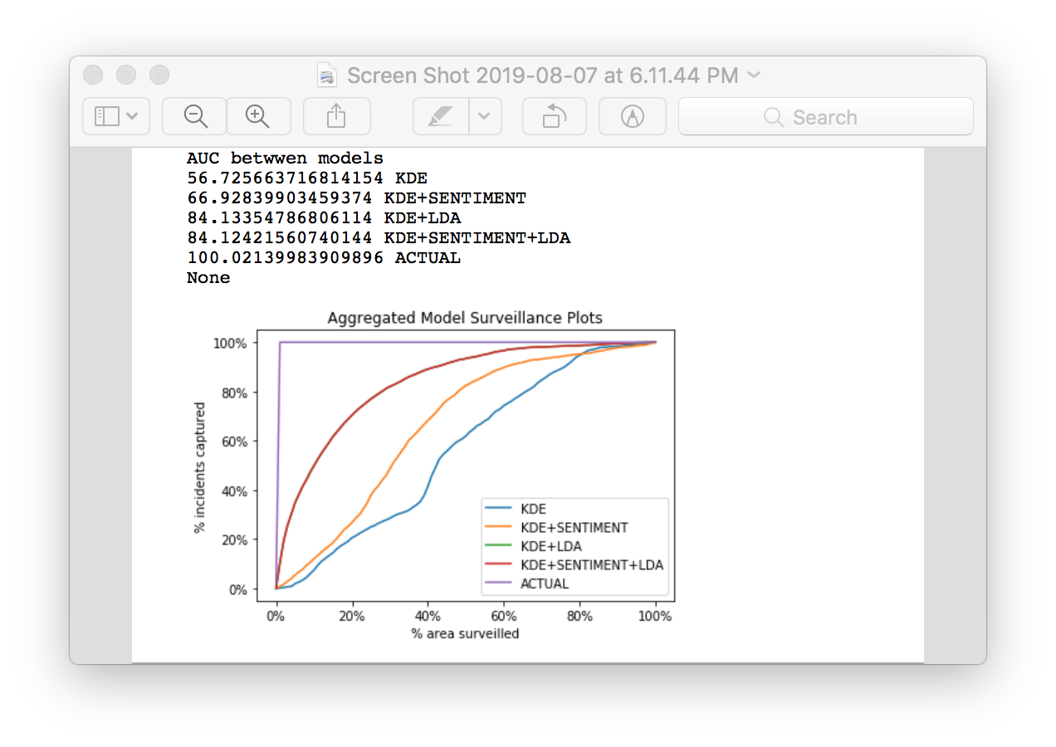
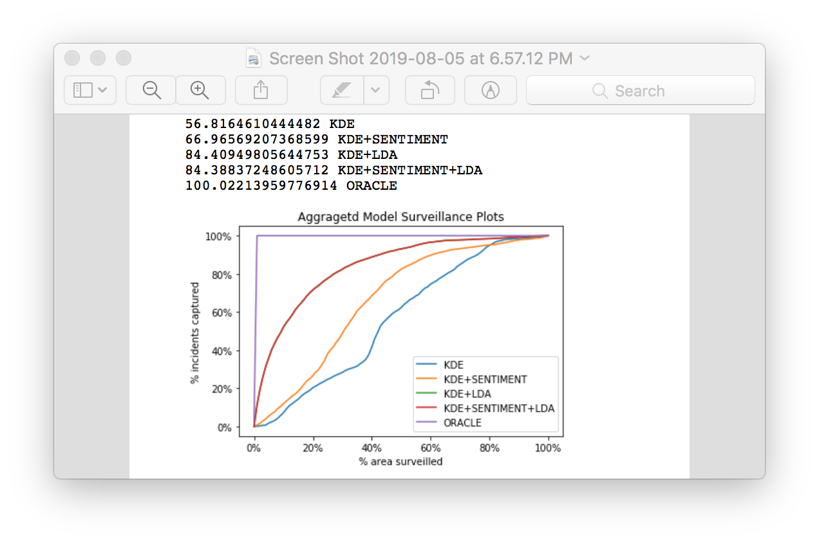
Crime Type - Theft
AUC – One day Prediction
AUC – Aggregated Plot for 10 days prediction
Planning Phase Preparation Phase Modeling Phase Conclusion

Slide 19
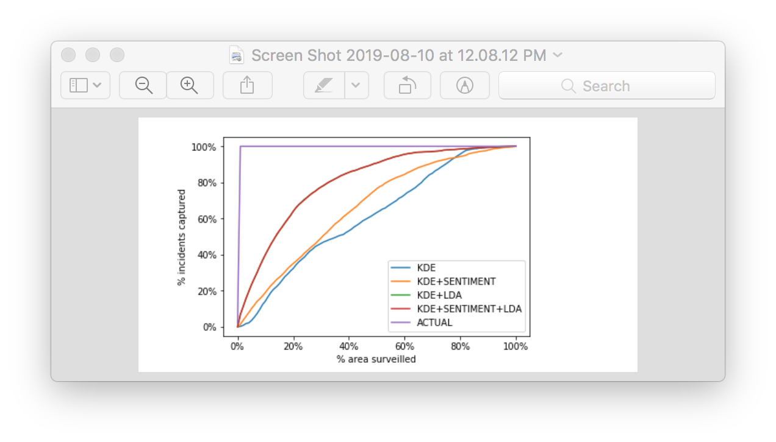
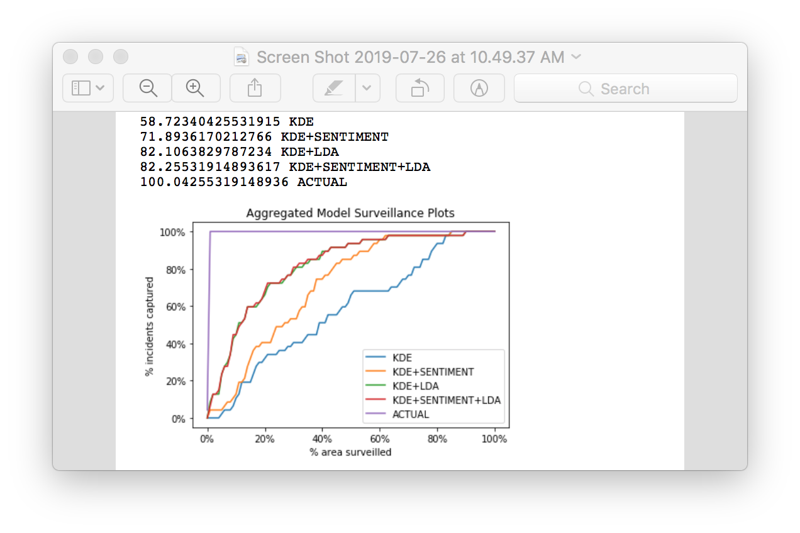
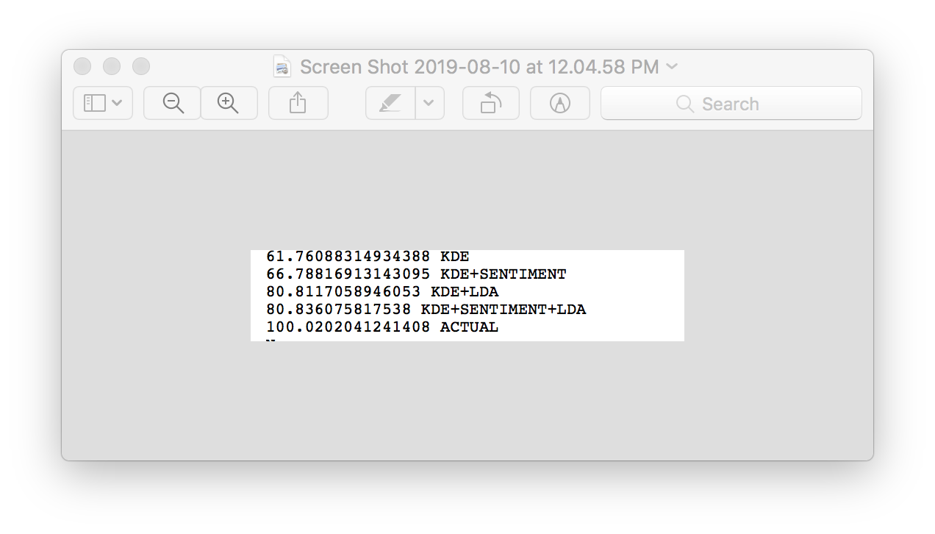
Crime Type - Battery
AUC – One day Prediction
Planning Phase Preparation Phase Modeling Phase Conclusion

Slide 20
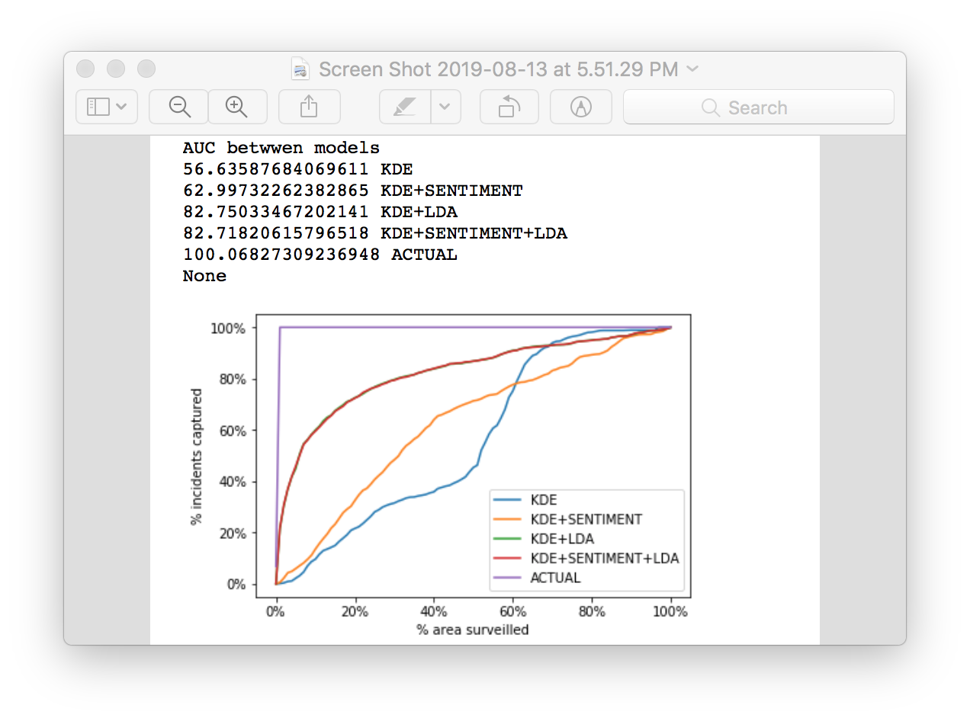
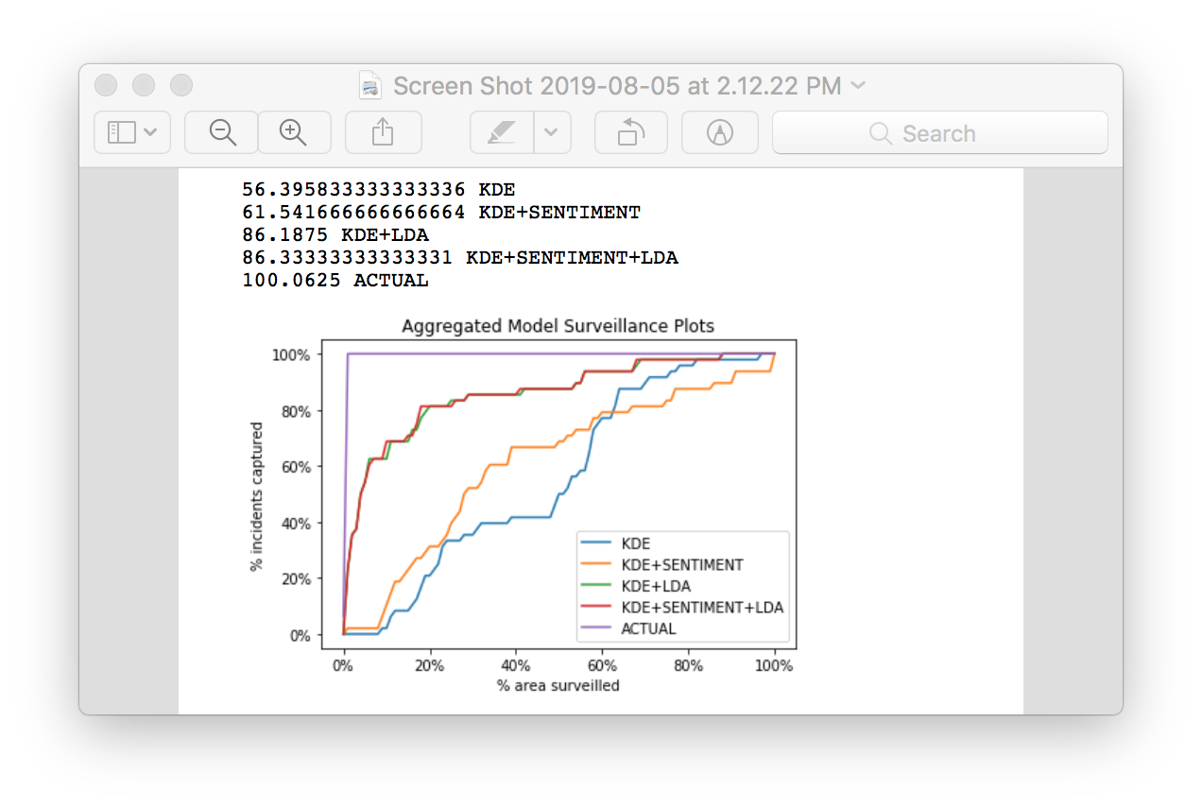
Crime Type - Narcotics
AUC – One day Prediction
Planning Phase Preparation Phase Modeling Phase Conclusion

Slide 21
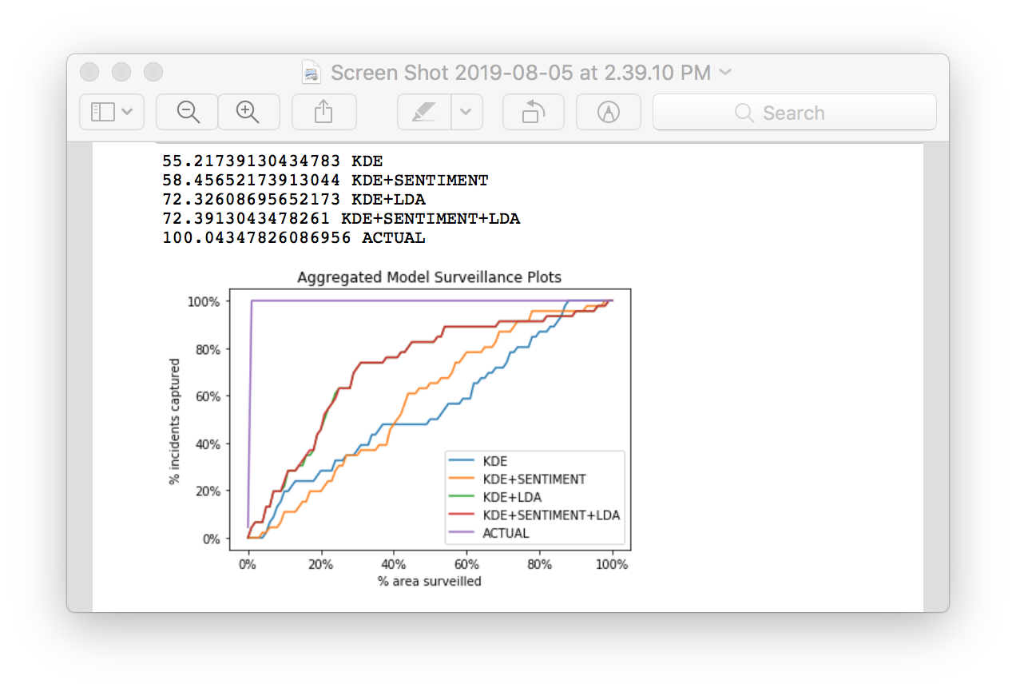
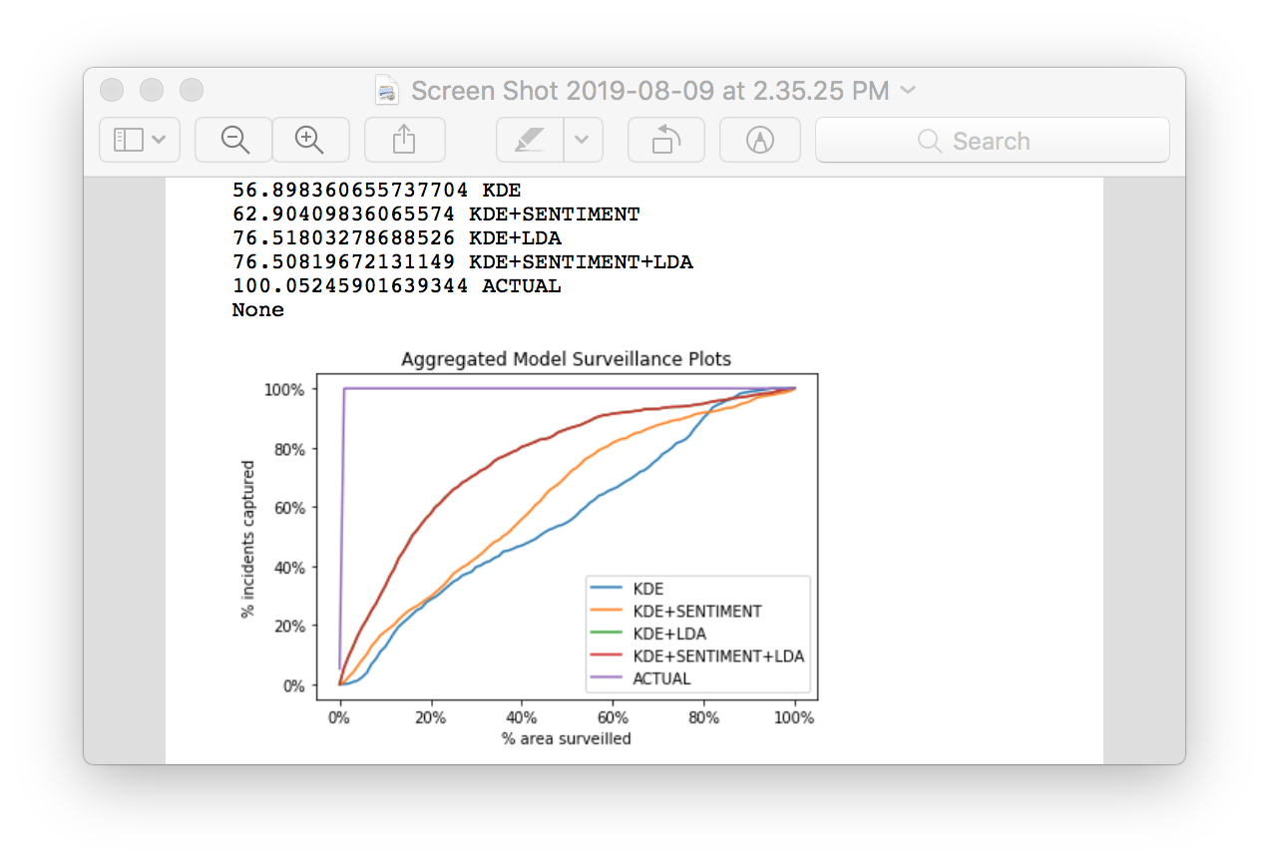
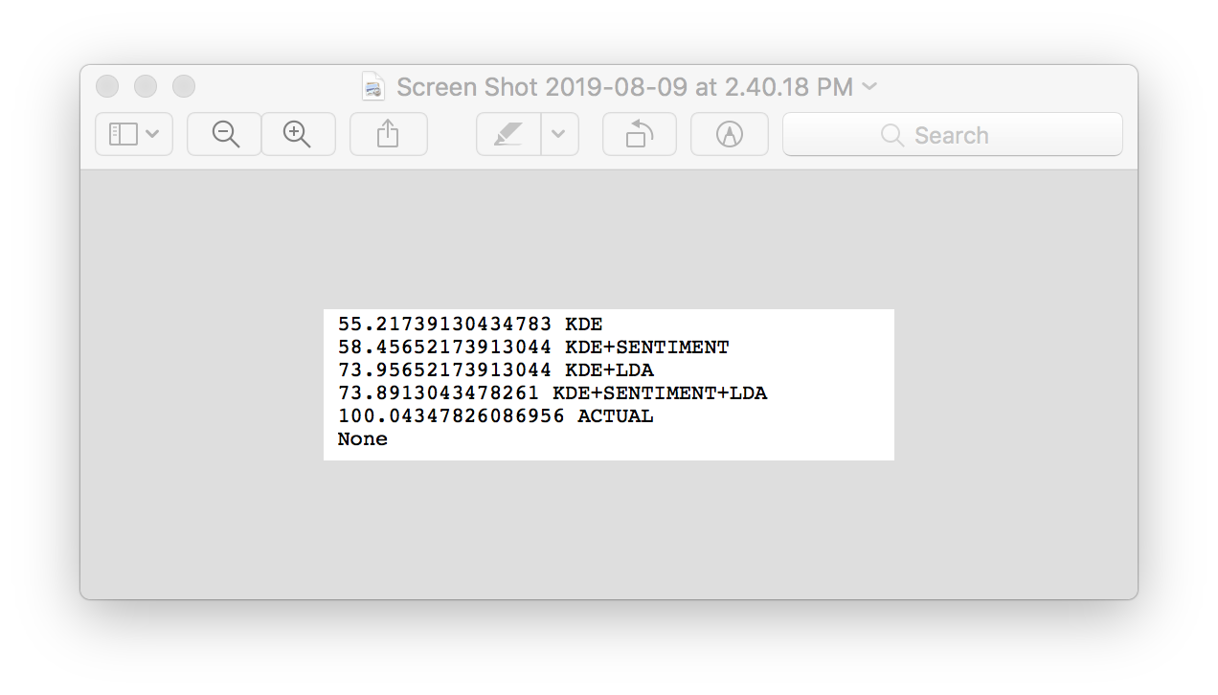

Crime Type - Burglary
AUC – One day Prediction
AUC – Aggregated Plot for 10 days prediction
Planning Phase Preparation Phase Modeling Phase Conclusion

Slide 22
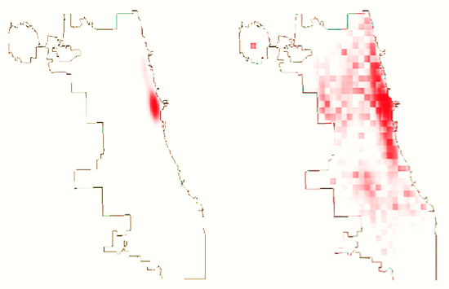
Crime prediction (Theft)
Predicted hotspots using KDE
Predicted hotspots using KDE+LDA
Planning Phase Preparation Phase Modeling Phase Conclusion

Slide 23
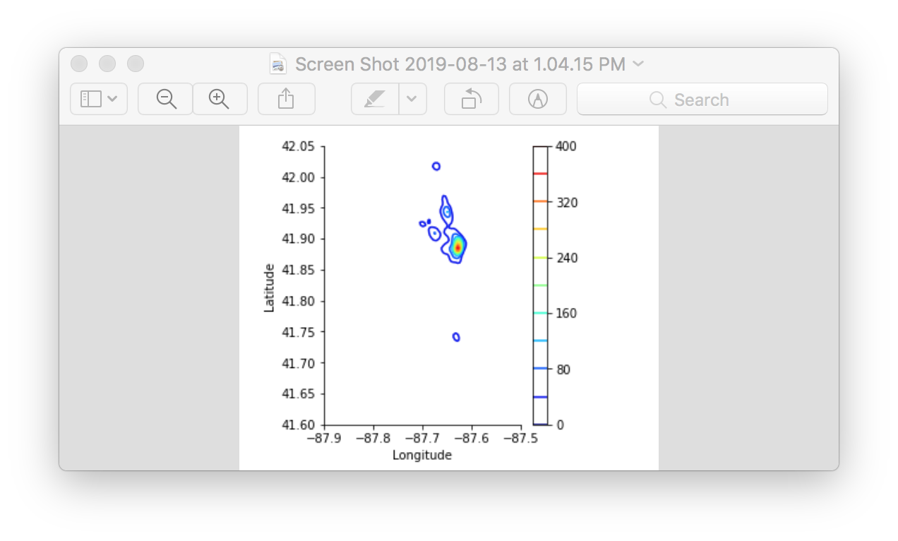
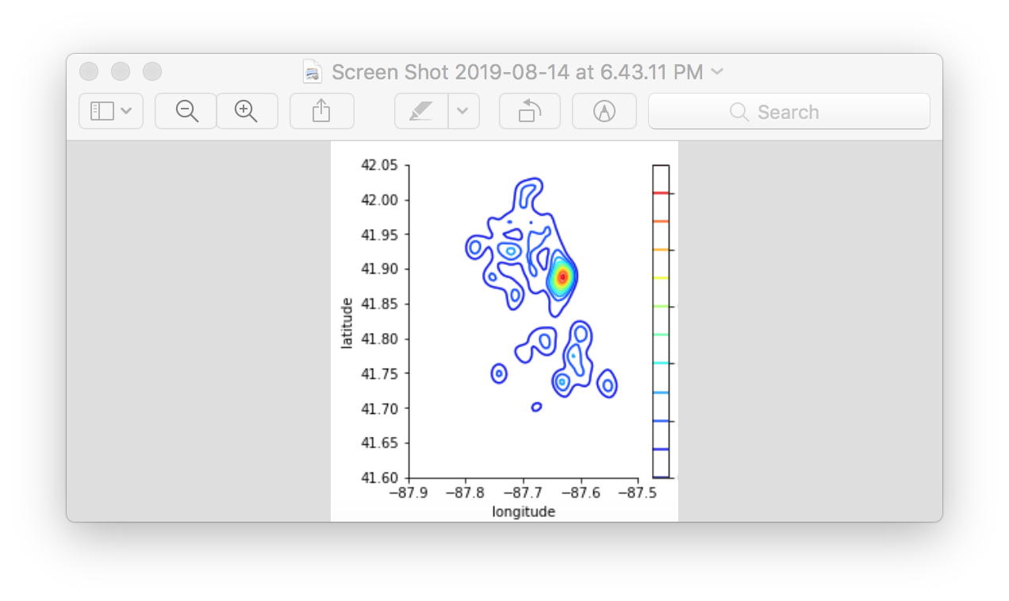
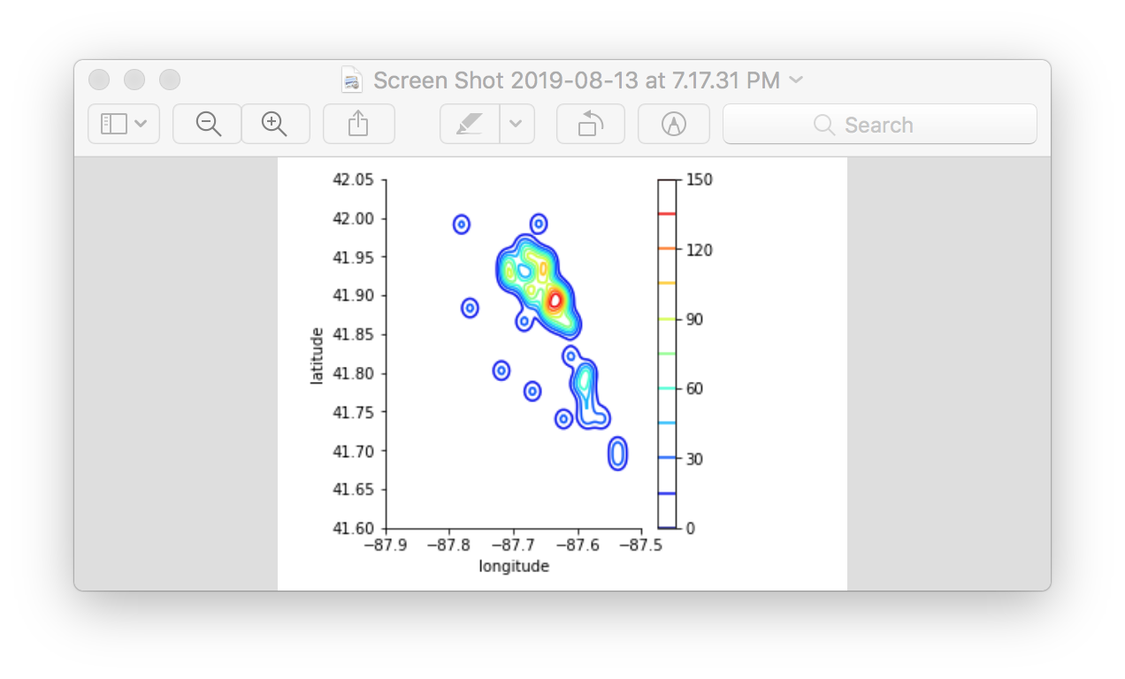
Model Evaluation
KDE generated Hotspots Actual Hotspots KDE+LDA generated Hotspots
Planning Phase Preparation Phase Modeling Phase Conclusion

Slide 24
Conclusion
The best model for crime hotspot prediction is using Kernel density estimation and LDA topic models, as it yields the best AUC (Area Under the Curve).
Using the best model, decision makers can allocate scarce resources (e.g., police patrols) across the geographic space, more efficiently, leading to reduction in wasted effort and decrease in crime response time.
Only for 19 of the 25 crime types studied, the addition of Twitter data improves crime prediction performance versus a standard approach based on kernel density estimation.
Planning Phase Preparation Phase Modeling Phase Conclusion
Notes:
Homicide/ Weapons AUCS remain same
Public Peace violation / Arson/ Kidnapping/ Intimidation the AUCS drop by range 6 to 14 percent.

